Slide 1
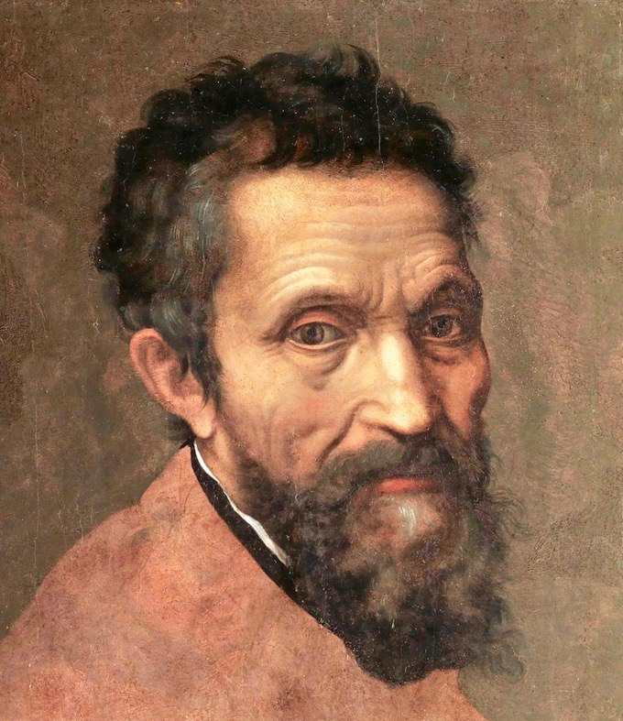
Bellwork 2-10-20
Compare the two Renaissance-era self-portraits and answer the following questions on your bellwork:
In what ways are the paintings similar?
In what ways are the paintings different?
Do you like one better than the other? Explain.

Slide 2
Bellwork 2-11-20
A period of intellectual and artistic creativity begins in Italy around the 1300s
Artists and writers revive techniques, styles, and subjects from classical Greece and Rome and celebrate human achievements (humanism)
Renaissance ideas spread to Northern Europe, where German and Flemish artists create distinctive works of art
Thousands of books and pamphlets created on printing presses spread political, social, and artistic ideas
Martin Luther starts a movement for religious reform and challenges the authority of the Catholic Church
King Henry VIII breaks ties with the Catholic Church and starts the Church of England, with the monarch as head of the Church.
Answer the following questions on your bellwork form:
What was the Renaissance?
How did the ideas and achievements of the Renaissance spread widely and quickly?
Why would ideas about humanism possibly lead to challenges to the authority of the Catholic Church? Explain.

Slide 3
Bellwork 2-12-20
Read pages 486-487 on “City Life in Renaissance Europe” and complete the following on your bellwork form:
1. What were some of the problems with city life, especially for the poor of London, during this time?
2. What were some of the similarities between city life in the Renaissance and today?

Slide 4
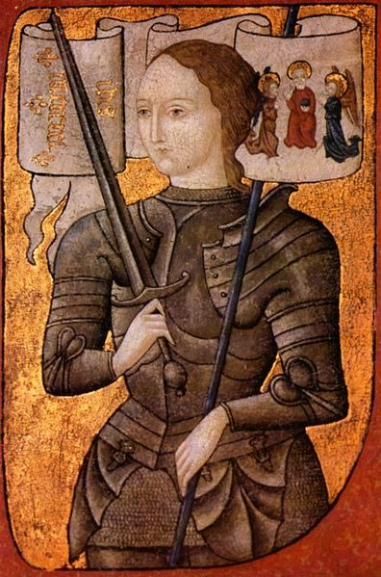
Bellwork 2-13-20
Read the three paragraphs on page 314 and answer the following questions in your three-ring binders using complete sentences:
Who is this reading selection about?
Why is she famous?
What is an Inquisition?
What is a heretic?

